Slide 1
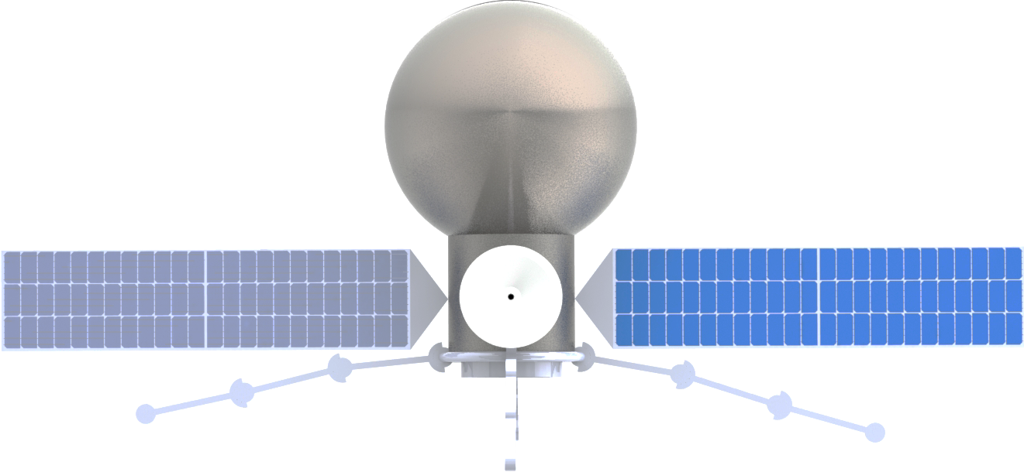



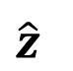
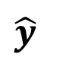

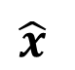
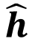
Fuel Tank
Hub
$$\hat{x}$$
$$\hat{y}$$
$$\hat{z}$$
High-Gain Antenna
$$\hat{w}$$
Solar Cells
$$\hat{w}$$
$$\hat{l}$$
$$\hat{h}$$
$$\hat{l}$$
$$\hat{h}$$
Docking Port

Slide 2

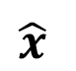
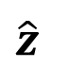
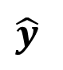
$$\hat{x}$$
$$\hat{y}$$
$$\hat{z}$$

Slide 3
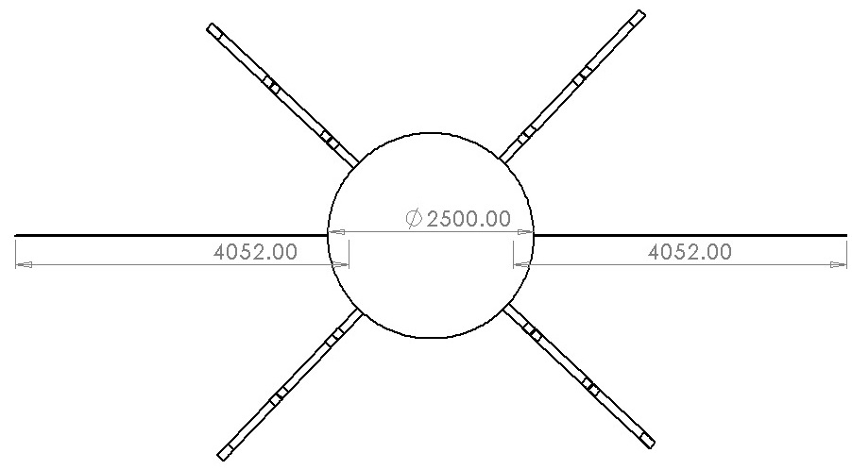

Slide 4
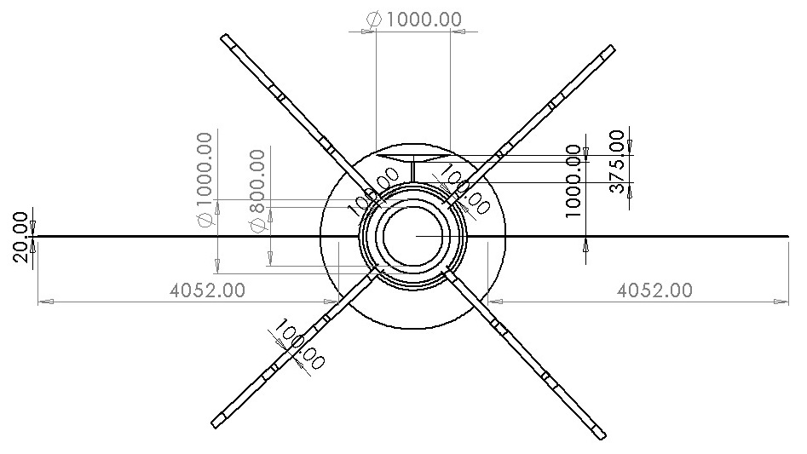

Slide 5
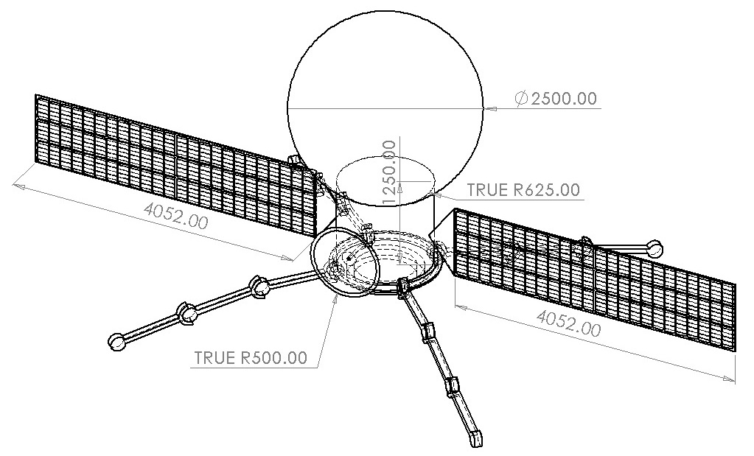

Slide 6
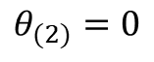
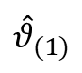
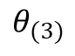
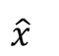
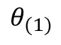
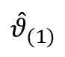
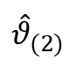
$${\hat{θ}}_{(1)}$$
$$\hat{x}$$
$$θ_{(3)}$$
$$θ_{(2)}=0$$
$${\hat{θ}}_{(2)}$$
$$θ_{(1)}$$
$${\hat{θ}}_{(1)}$$

Slide 8
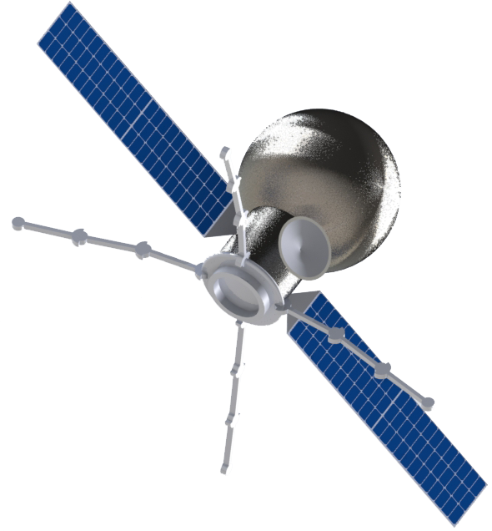
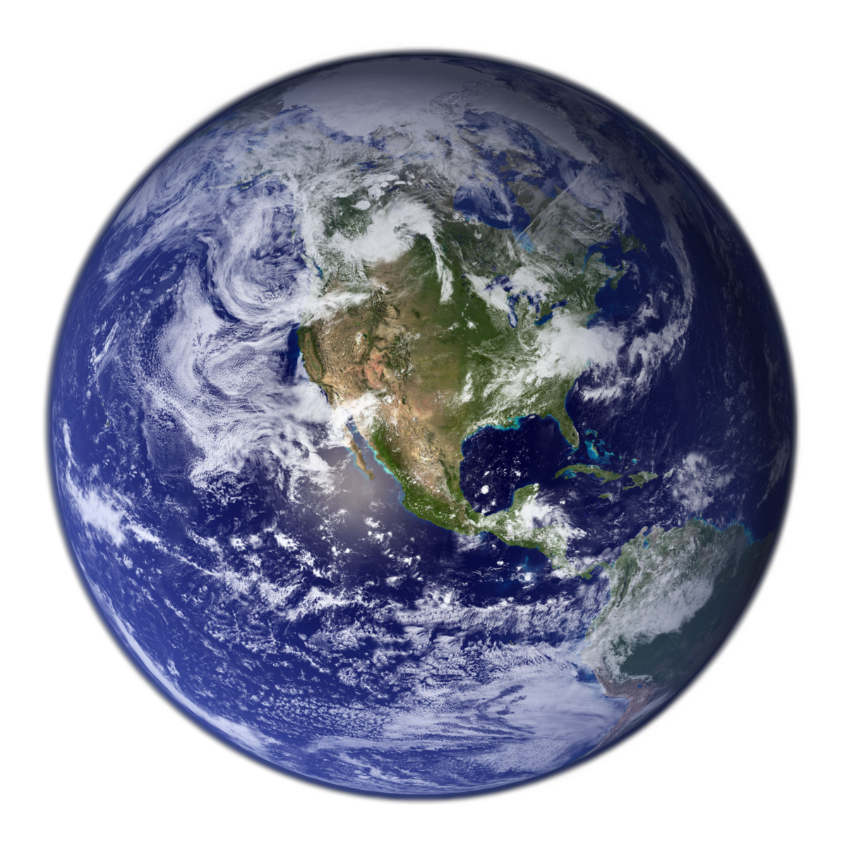
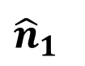
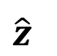
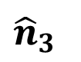
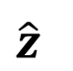
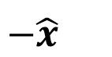
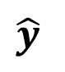
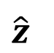
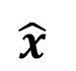
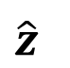
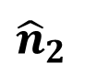
$$\hat{z}$$
$$\hat{y}$$
$$\hat{x}$$
$$\hat{z}$$
$${\hat{n}}_{3}$$
$$\hat{z}$$
$${\hat{n}}_{1}$$
$${\hat{n}}_{2}$$
$$−\hat{x}$$
$$\hat{z}$$

Slide 9
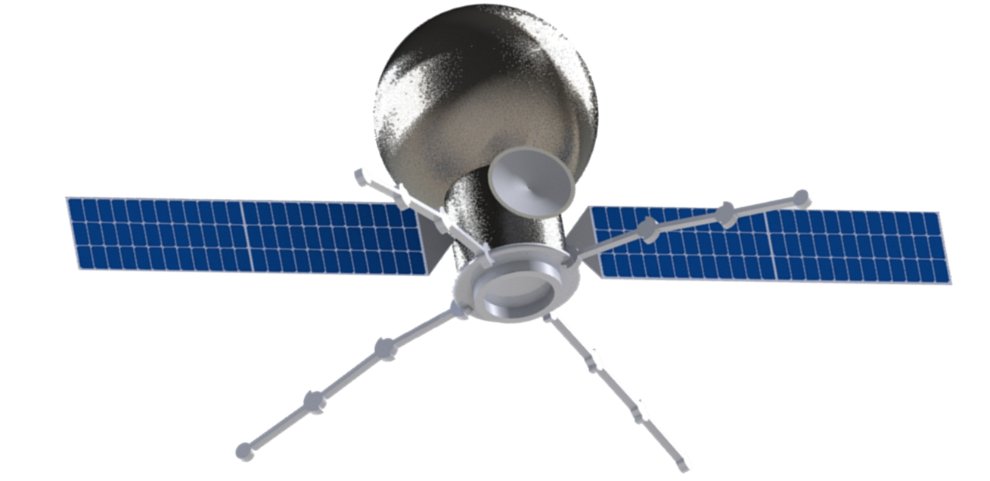
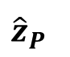
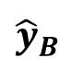
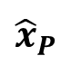
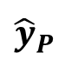
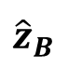
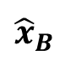
$${\hat{x}}_{P}$$
$${\hat{x}}_{B}$$
$${\hat{z}}_{B}$$
$${\hat{z}}_{P}$$
$${\hat{y}}_{P}$$
$${\hat{y}}_{B}$$

Slide 10
class Spacecraft():
ORBIT STATE REPRESENTATION
ATTITUDE STATE REPRESENTATION
Spacecraft.states
*XYZ coordinates in ECI (J2000) frame
Spacecraft.attBN
Spacecraft.ohmBN
*Body to inertial attitude (coordinate agnostic)
*Body to inertial angular velocity (body-frame)
*Mutually updated for state consistency
Spacecraft.elements
Spacecraft.attBR
Spacecraft.ohmBR
*Equivalent orbital elements (osculating)
*Body to reference attitude (coordinate agnostic)
*Body to reference angular velocity (body-frame)
ORBIT PROPAGATION METHODS
ATTITUDE PROPAGATION METHOD
Spacecraft.propagate_orbit(self, dt)
Spacecraft.propagate_attitude(
self, dt, torque)
*Keplerian-only analytical two-body propagator
Spacecraft.propagate_orbit(
self, t, dt, integrator='RK4')
*Torque as a 3x1 vector applied in body-frame coordinates
*Numerical propagator (default RK4), with references to own force models

Slide 11
RCV
RCV
RCV
RCV
RCV
RCV
RCV
RCV
1
2
3
4

Slide 12
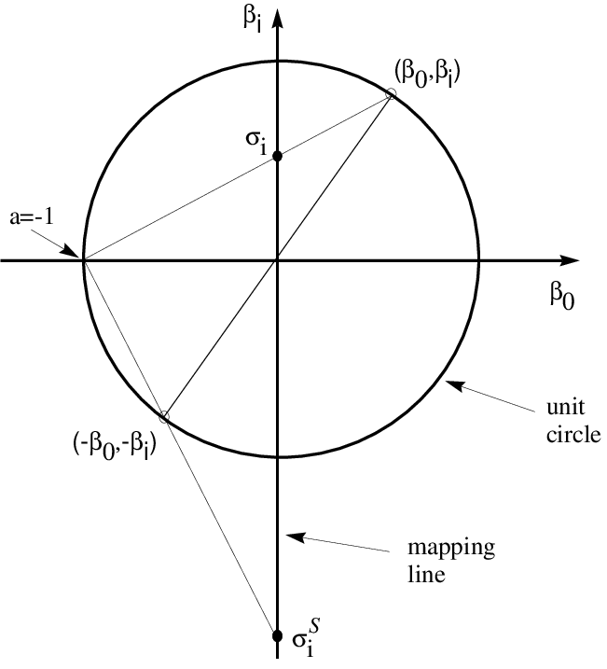
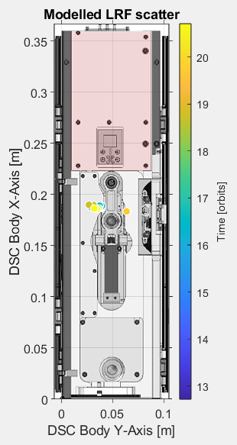
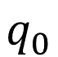
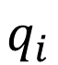
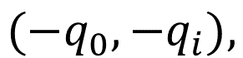
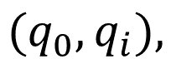
With hat error
$$q_{i}$$
$$(q_{0},q_{i}),$$
$$q_{0}$$
$$(−q_{0},−q_{i}),$$

Slide 13
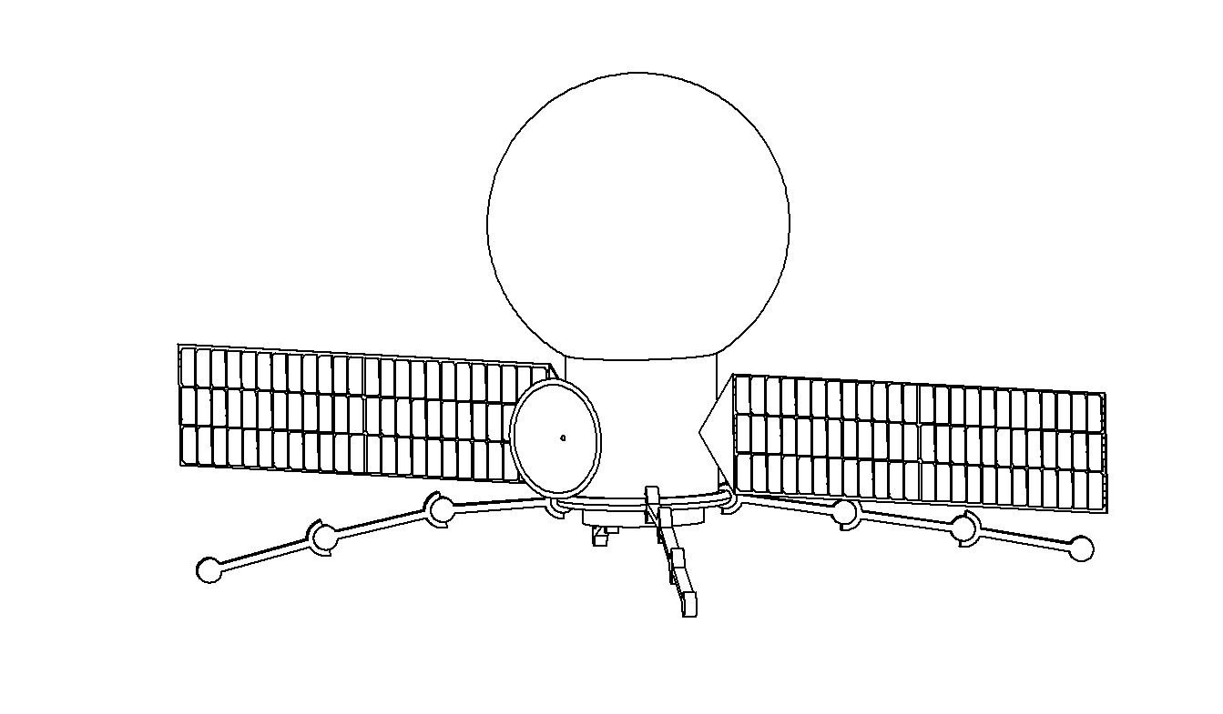
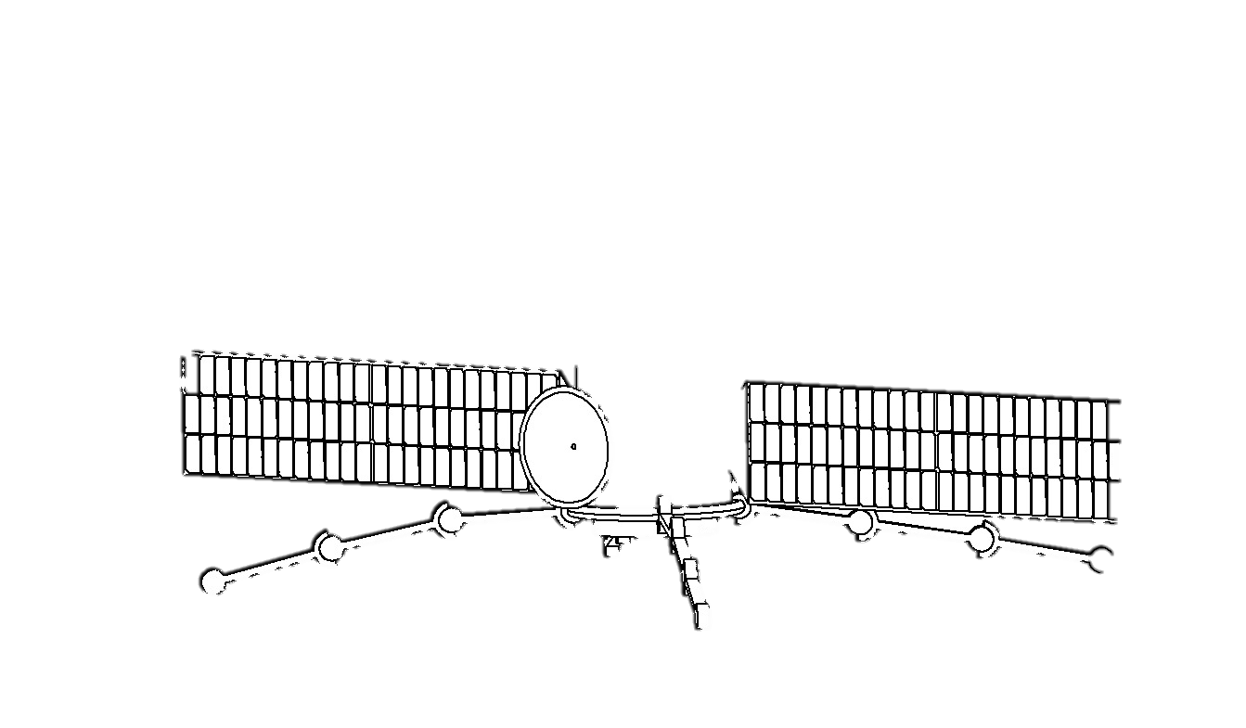
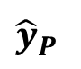
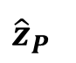
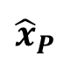
40cm radius,
10cm height,
Ti-6Al-4V
$${\hat{x}}_{P}$$
$${\hat{y}}_{P}$$
$${\hat{z}}_{P}$$

Slide 14
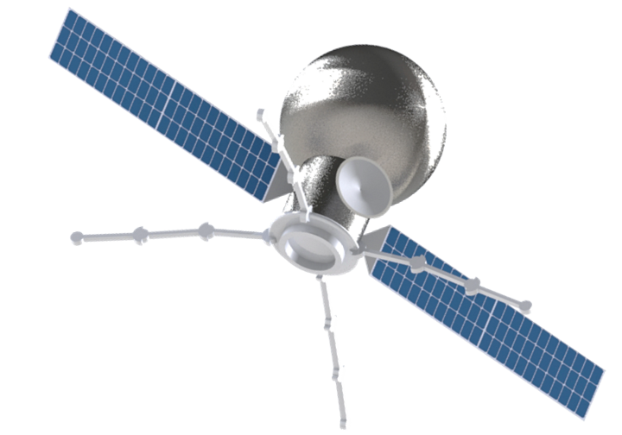
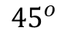







$${\hat{y}}_{B}$$
$$\hat{R}$$
$${\hat{x}}_{B}$$
$$\hat{T}$$
$${45}^{o}$$
$${45}^{o}$$
$$\hat{N}$$
$${\hat{z}}_{B}$$

Slide 15



$$\hat{R}={\hat{x}}_{B}$$
$$\hat{T}={\hat{y}}_{B}$$
$$\hat{N}={\hat{z}}_{B}$$

Slide 16




$$\hat{T}={\hat{x}}_{B}$$
$$−\hat{R}={\hat{y}}_{B}$$

Slide 17













$${\hat{z}}_{P}$$
$${\hat{x}}_{P}$$
$$≤{90}^{o}$$
$${\hat{z}}_{P}$$
$${\hat{x}}_{P}$$
$${\hat{y}}_{P}$$
$$≤{90}^{o}$$
$${\hat{y}}_{P}$$
$${\hat{x}}_{P}$$
$${\hat{z}}_{P}$$
$${\hat{y}}_{P}$$

Slide 18

Day 4
Day 3
Day 5
Day 0: Initial profile
Day 2
Day 1

Slide 19



$${\hat{z}}_{P}$$
Sun Sensor
Star Tracker
$${\hat{x}}_{P}$$
$${\hat{y}}_{P}$$
$${\hat{y}}_{P}$$
Sun Sensor
Star Tracker
$${\hat{z}}_{P}$$

Slide 20






$${\hat{z}}_{P}$$
Sun Sensor
Star Tracker
$${\hat{x}}_{P}$$
$${\hat{y}}_{P}$$
$${\hat{y}}_{P}$$
$${\hat{z}}_{P}$$
Sun Sensor
Star Tracker

Slide 21
$${\hat{x}}_{P}$$
$${\hat{y}}_{P}$$
$${\hat{z}}_{P}$$

Slide 22

$${30}^{o}$$
$${30}^{o}$$
$${30}^{o}$$
$${30}^{o}$$

Slide 23
Mission-Level Requirements and Considerations
Component must be radiation-protected and rated for GEO-class operations. Flight or pre-flight heritage, minimally TRL 8 and flight qualified with MIL-STD-1553B (MIL grade), or ECSS-Q-ST-60-15C (ESA standard), or recommended TID by NASA NEPP standards.
Functional Level Requirements and Considerations
There must be sufficient sensor redundancies to maintain observability to sources (stars or sun) in all identified configurations, including the possibility of occlusion by the target during rendezvous.
3-axis controllability is possible about all principal axes.
Performance Level Requirements and Considerations
Minimum control torque per actuator exceeds maximum total expected perturbation, for disturbance rejection.
Coarse and fine attitude determination and control accuracy requirements (see Table: Mission modes with attitude profiles mapped to requirements).

Slide 24


Slide 25


Slide 26









Hardware Sensor Simulator
Navigation
Controller
Data Interface
Guidance
$$\left[{}_{ }^{R}{q_{N}},{}_{ }^{R}{ω_{N}}\right]$$
Star Catalog
(Inertial Frame)
Multiplicative EKF
Lyapunov Control Law (MRP)
Gyroscope simulator
Time Update
$$+B\vec{u}$$
Map control torques to wheel torques
$$\vec{u}$$
State Estimate
$$\left[{}_{ }^{B}{q_{N}},{}_{ }^{B}{ω_{N}}\right]$$
Measurement Update
Hardware Actuator Simulator
Reaction Wheels
Thrusters
Reference Attitude Update
Control input $\vec{u}$to state estimator

Slide 27

6
5
4
7
3
2
8
Frame 1
9
10
12
11

Slide 28

18
17
16
19
15
14
20
21
Frame 13
22
23
24

Slide 29

Normal [km]
Tangential [km]
Radial [km]

